Slide 1

Impact of Inflation

Slide 2
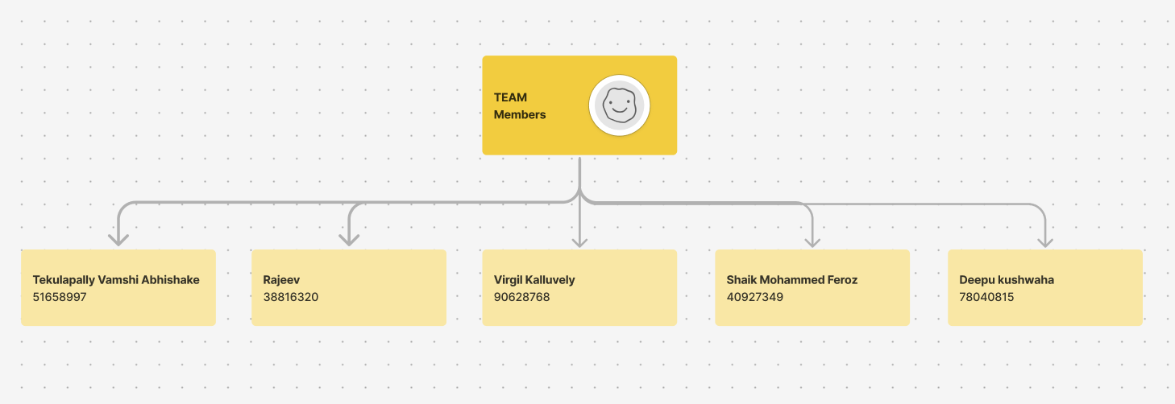

GROUP MEMBERS

Slide 3
INTRODUCTION
Inflation and exchange rates are among the major study areas in economics. A change in the exchange rate reflects the difference in the value of currencies, while the rate of inflation shows how fast prices are increasing.
This research will put inflation, along with the exchange rates between the USA and India, under comparison and analysis for the years 1980 to 2024.
Those are some of the important indicators followed by policymakers, investors, and economists in predicting economic trends, managing monetary policies, and assessing international competitiveness.

Slide 4
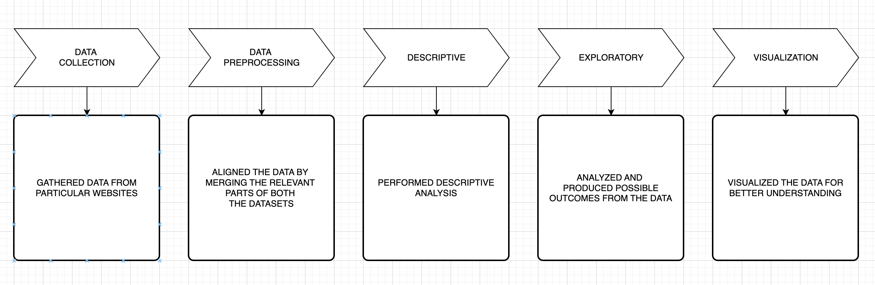
WORKFLOW OF THE PROCESS

Slide 5

DATA COLLECTION

Slide 6
Surfed through various websites.
Collected datasets based on the specific topic
In this research work, we gathered data from one of the most reputated website
Dataset files
Inflation Rates
USD & INR Exchange Rates

Slide 7
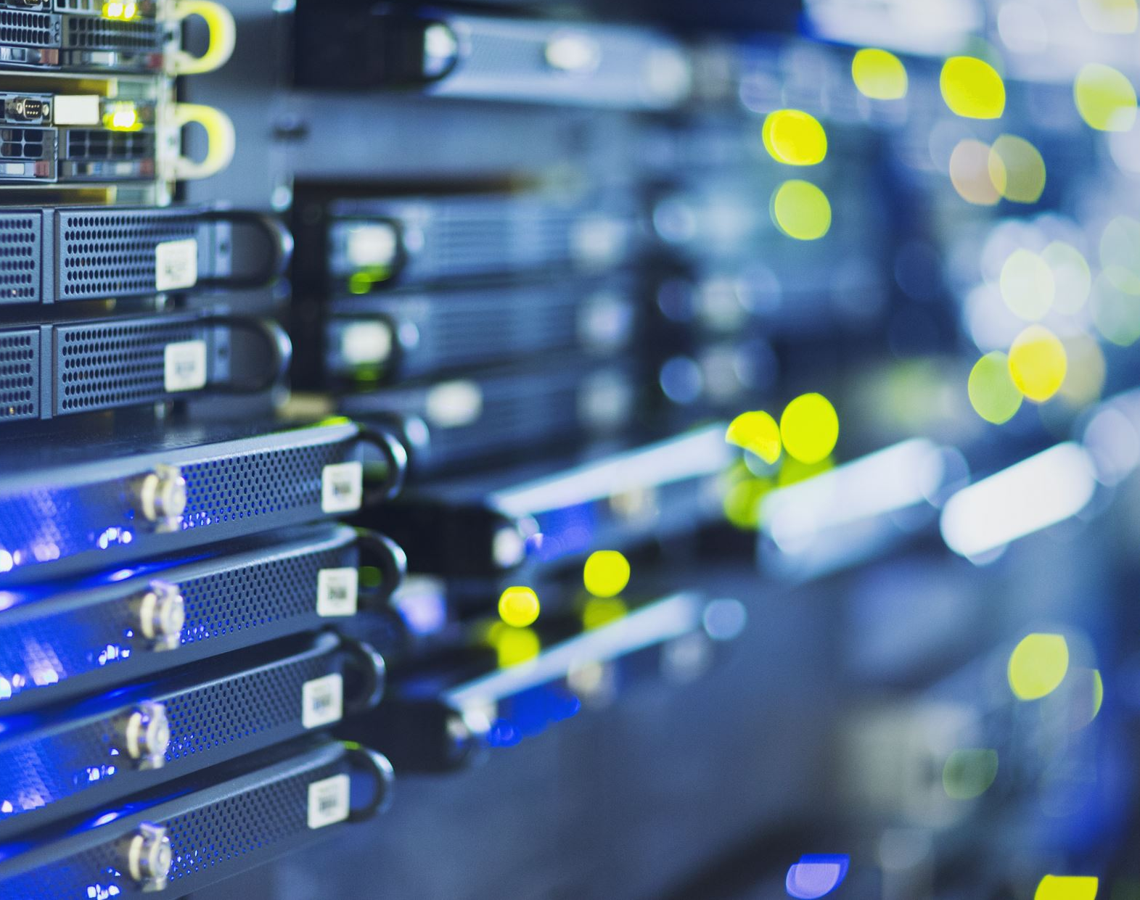
DATA CLEANING

Slide 8
Processed the data using python.
Presented the final data in Jupyter notebook.
Reviewed the data by using few and simple functions .

Slide 9
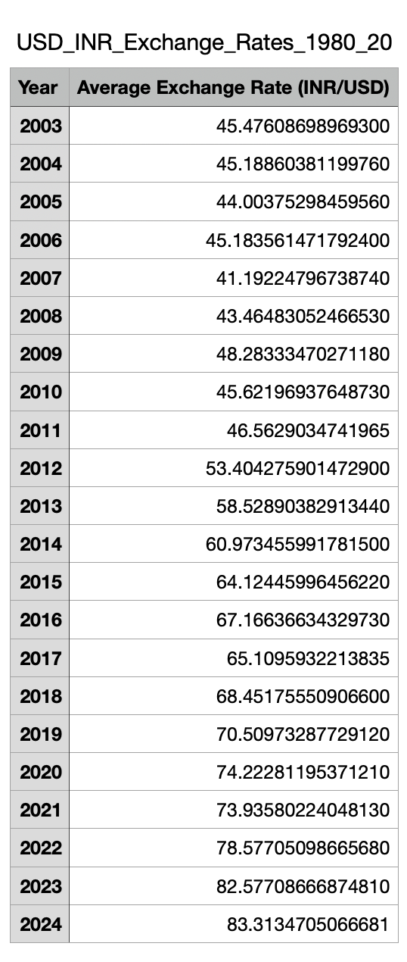
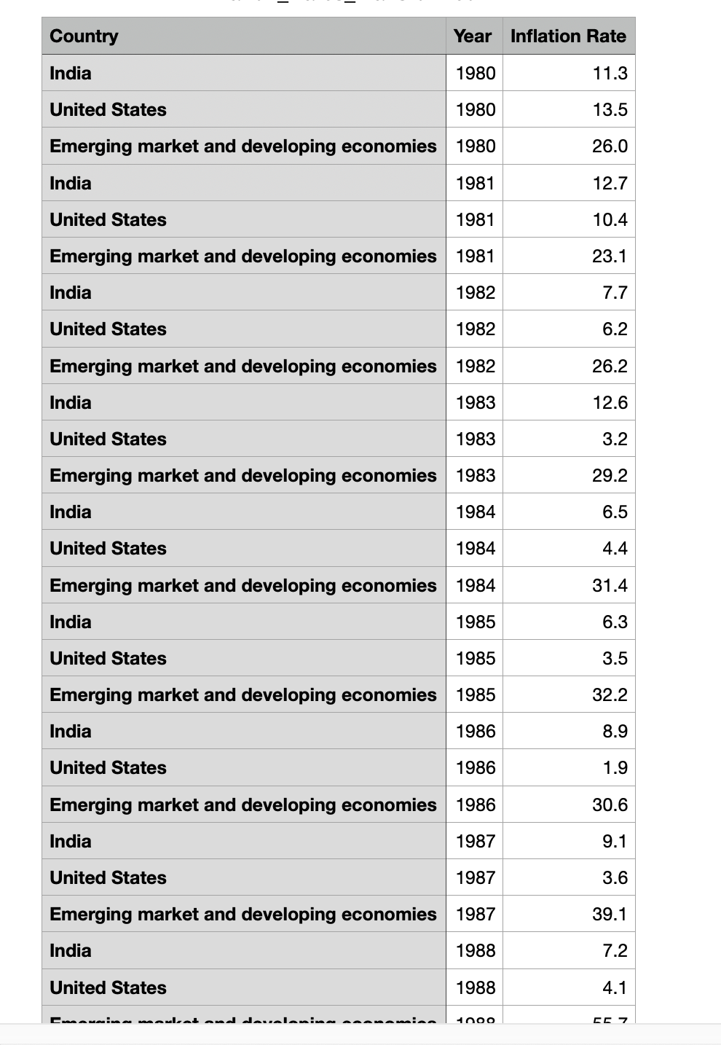
Glimpse of both Data Sets

Slide 10
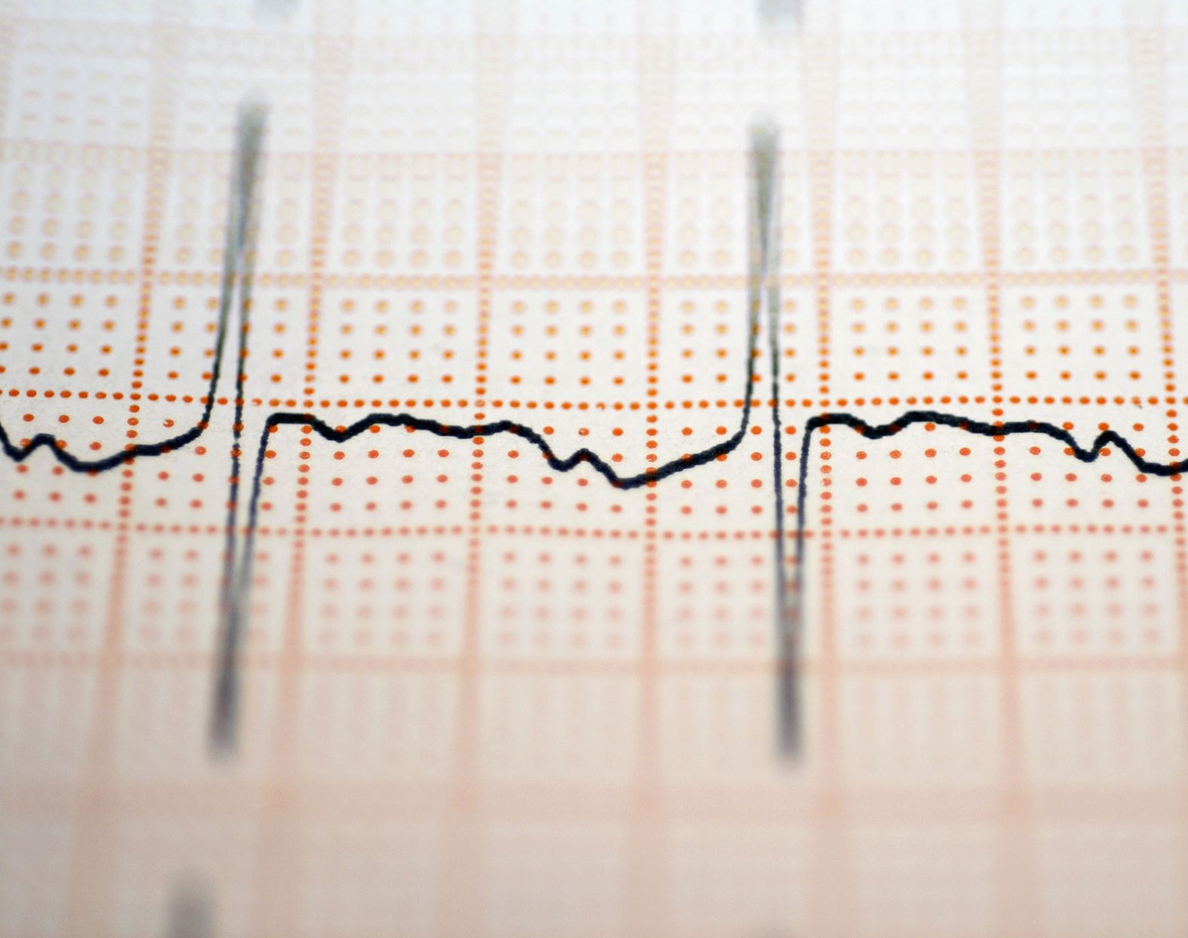
Descriptive Analysis

Slide 11
Performed analysis using python on Jupyter Software
Descriptively analysed each dataset for insightful information
Visualized the data into graphical depictions for the illustrations.

Slide 12

Exploratory Analysis

Slide 13
Estimate
Estimate the relationship between inflation rates and the exchange rate, allowing for possible lag effects.
Test
Test whether PPP theory holds up in practice by comparing the actual exchange rate with that implied by inflation differentials.
Describe
Describe any deviations of actual from PPP-based exchange rates so as to get hints on other possible economic factors that may be useful in explaining movements of exchange rates.

Slide 14
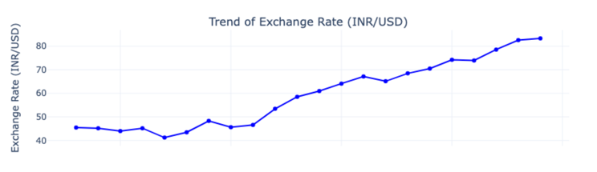
ESTIMATATION
The upward trend of the INR/USD exchange rate over time, indicating a steady depreciation of the Indian Rupee against the U.S. Dollar.
Factors such as inflation disparities, trade imbalances, and economic conditions likely contribute to this long-term depreciation pattern, reflecting broader macroeconomic trends.

Slide 15
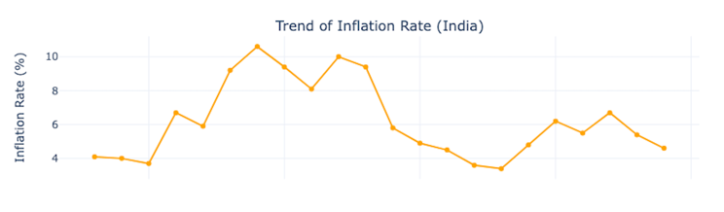
ESTIMATATION
The trend of inflation rates in India, with fluctuations between 4% and 10%.
Periods of peak inflation highlight economic challenges, while declines reflect stabilization efforts.
Such trends impact purchasing power, investment, and currency valuation, contributing to the observed exchange rate
depreciation over time.

Slide 16
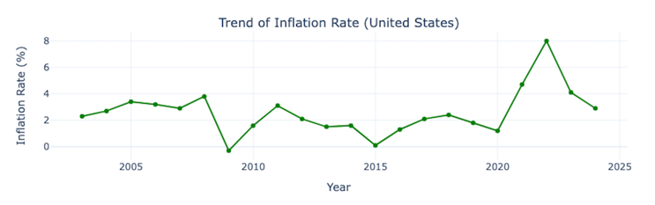
ESTIMATATION
U.S. inflation trends (2005-2025), highlighting stable rates around 2-4% until the 2008 financial crisis caused deflation.
Post-crisis recovery stabilized inflation, but COVID-19 disruptions in 2020 led to a sharp spike near 8%.
Subsequent Federal Reserve measures brought inflation down, reflecting economic adjustments and monetary tightening policies.

Slide 17
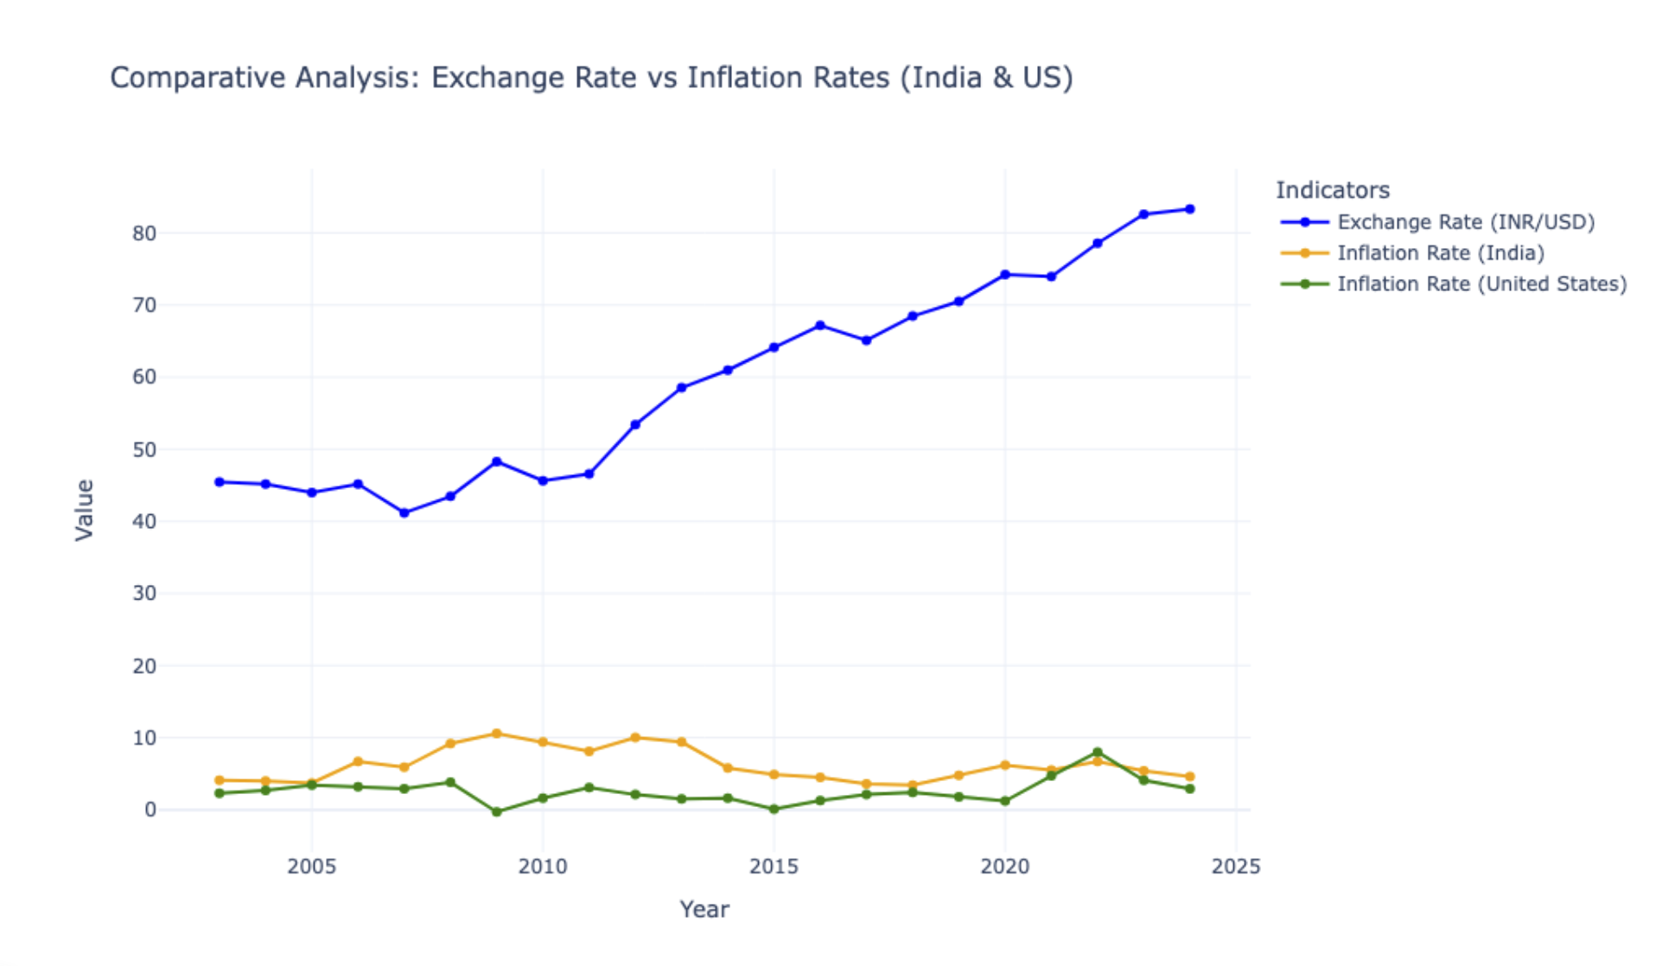
TEST
This chart compares three indicators: India's exchange rate (INR/USD), inflation rate in India, and inflation rate in the U.S. (2005–2025).
The exchange rate steadily rises, indicating rupee depreciation. India's inflation fluctuates more than the U.S.'s, which remains relatively stable over time.

Slide 18
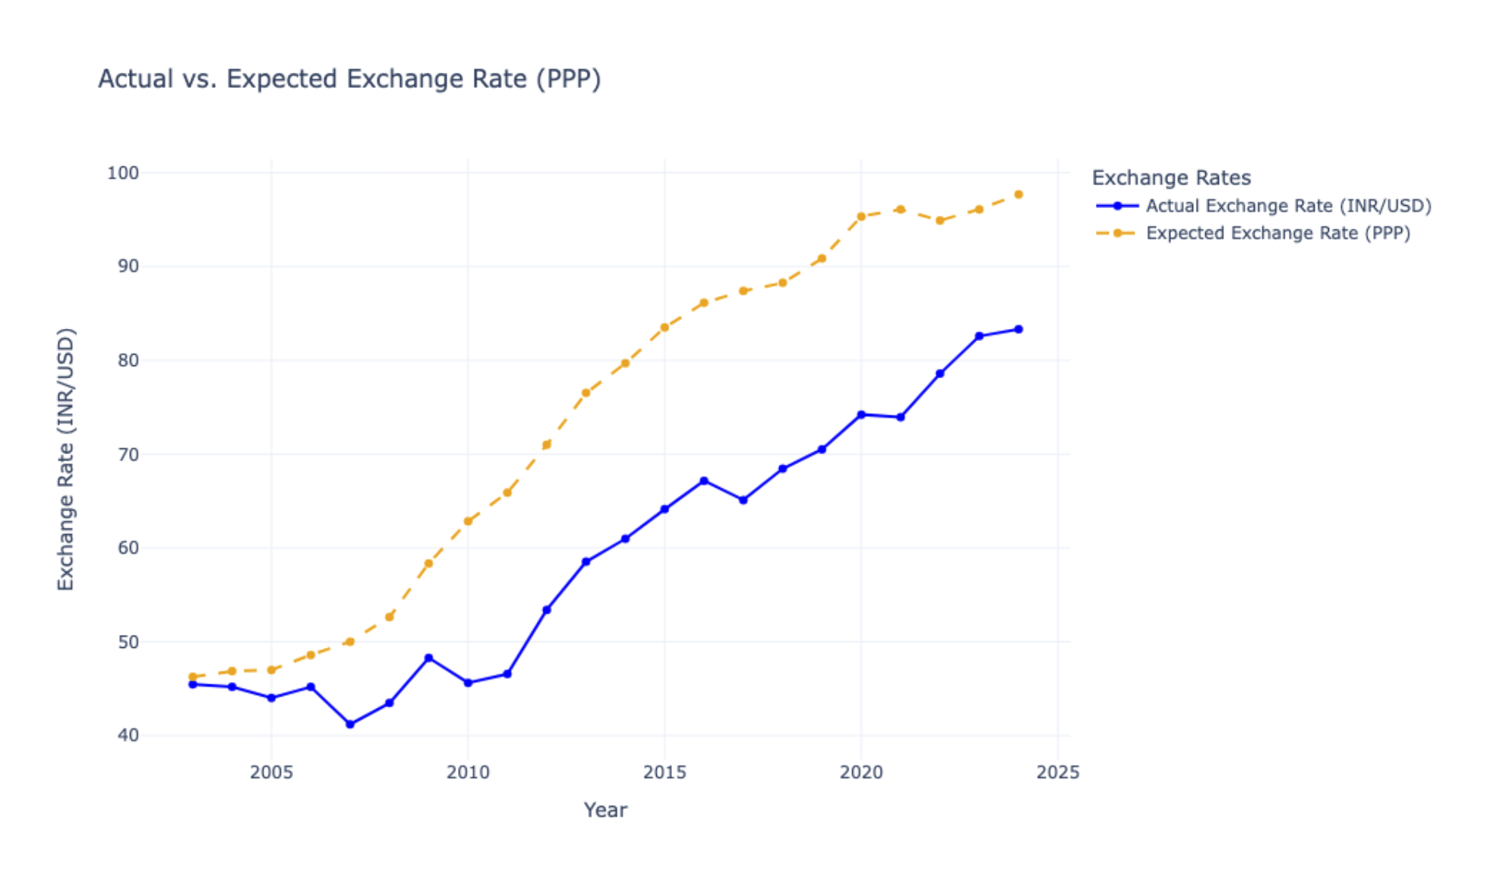
DESCRIBE
The actual INR/USD exchange rate with the expected exchange rate based on Purchasing Power Parity (PPP) from 2005 to 2025.
The actual rate rises steadily, indicating rupee depreciation, while the PPP rate grows faster, suggesting the rupee is undervalued relative to PPP predictions over time.

Slide 19
BENEFITS
To make the process easier of getting the economic insights for both Policy makers and Economists.
Gainful for Investors and Importer/Exporters by implementing business strategies.

Slide 20

CONCLUSION

Slide 21
Analysis reveals that there is a strong link between exchange rates and inflation; this reflects that India's higher inflation corresponds to the depreciation of INR against USD in line with PPP. However, deviations from the expected PPP rate indicate that there are other determinants affecting its currency movements: trade dynamics and market conditions, among other things.

Slide 22
THANKS

